Slide 1
Practical Trigonometry Problems

Slide 2
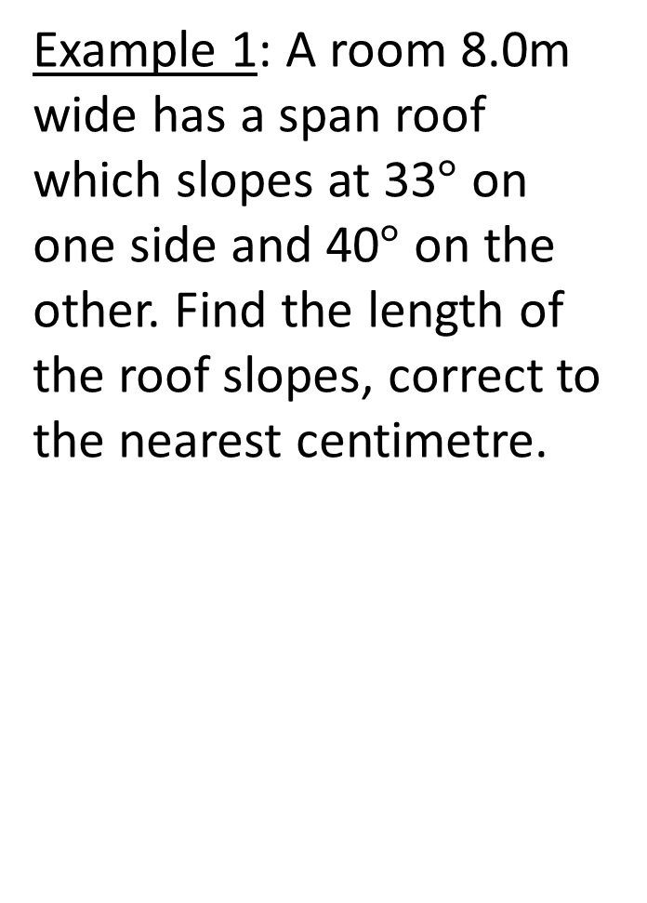
Example 1: A room 8.0m wide has a span roof which slopes at 33$°$ on one side and 40$°$ on the other. Find the length of the roof slopes, correct to the nearest centimetre.

Slide 3
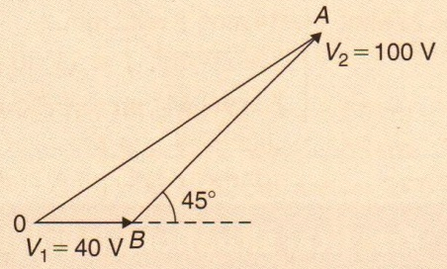
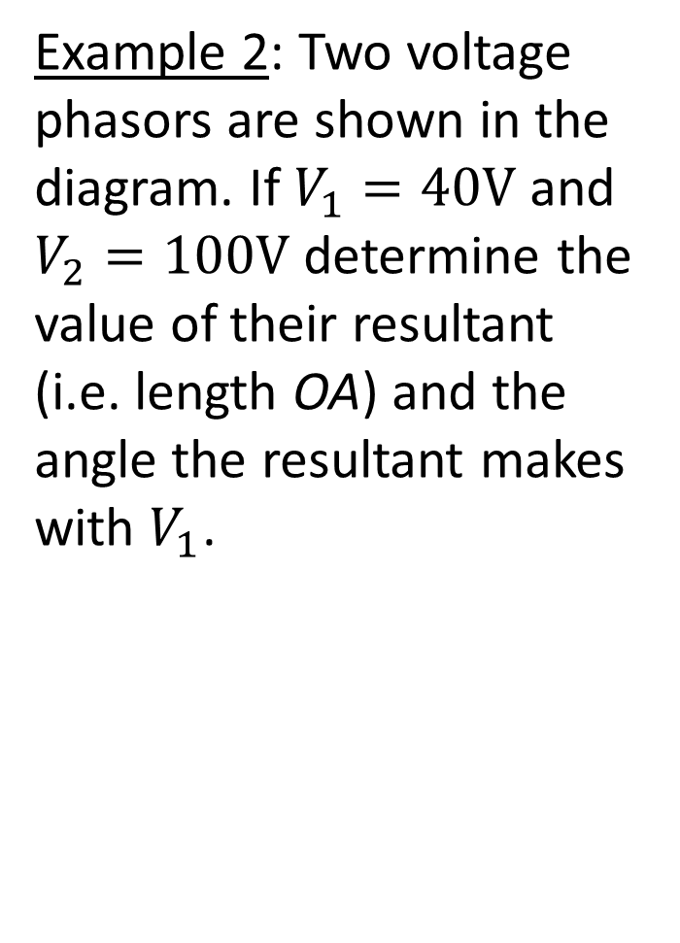
Example 2: Two voltage phasors are shown in the diagram. If $V_{1}=40V$ and $V_{2}=100V$ determine the value of their resultant (i.e. length OA) and the angle the resultant makes with $V_{1}$.

Slide 4
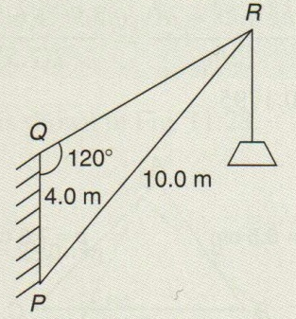
Example 3: In the diagram, PR represents the inclined jib of a crane and is 10.0m long. PQ is 4.0m long. Determine the inclination of the jib to the vertical and the length of tie QR.

